Slide 1
Global Recruiting Trends
From candidate roller decks to CRM
From hire and fire to nurture and develop
From 9-5 to 24/7
From desktop to virtual

Slide 2
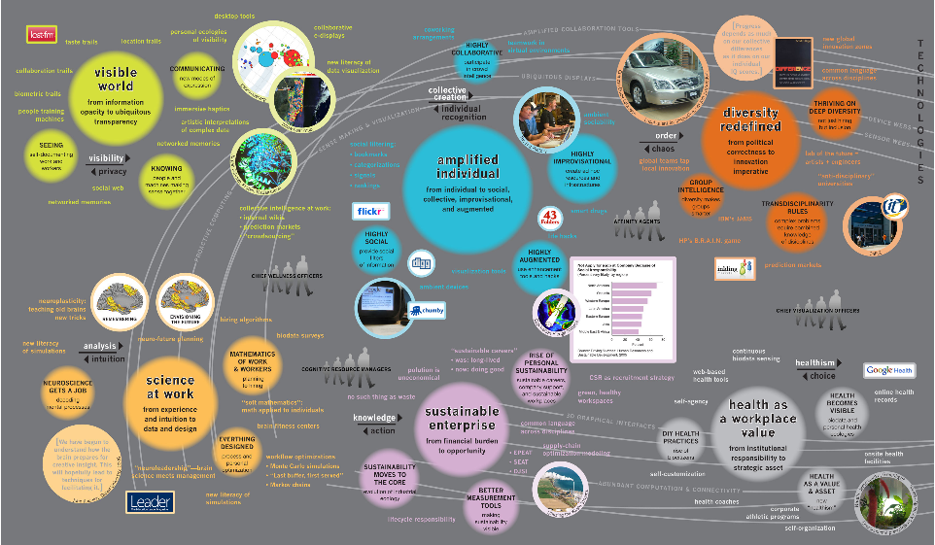
Institute for future The Intersection of Work and Technology 2007

Slide 3
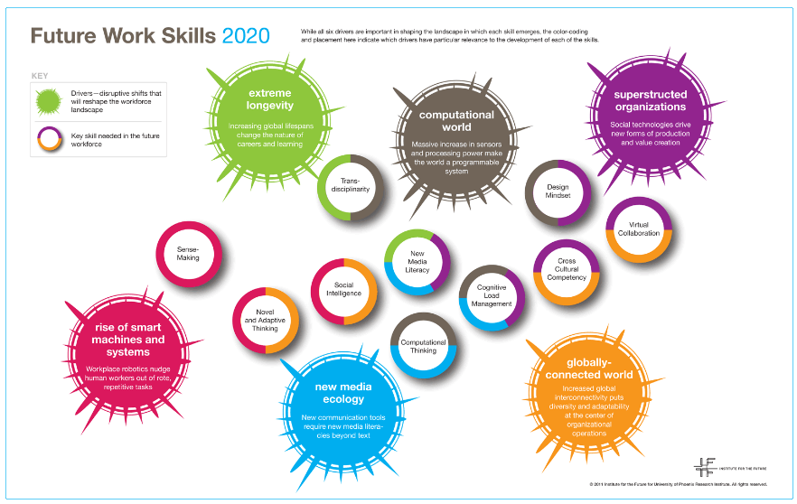
Institute for future The Re-working of "Work" 2011

Slide 4
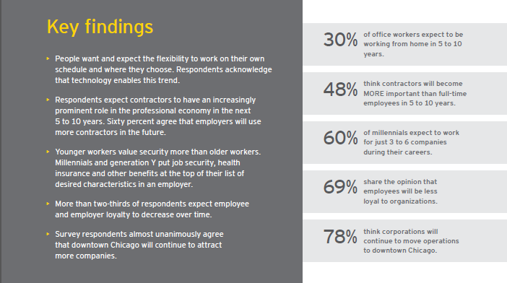
E&Y world of work changing 2012

Slide 5
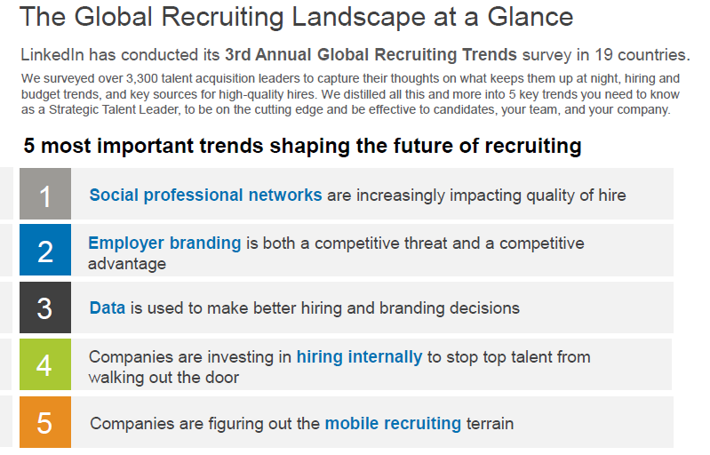
Linkedin global recruiting trends 2013

Slide 6
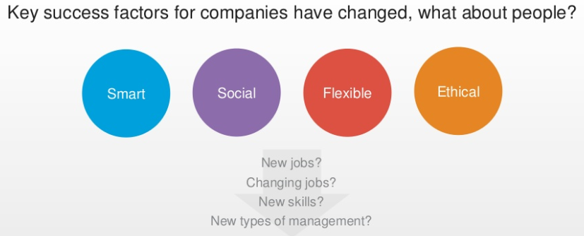
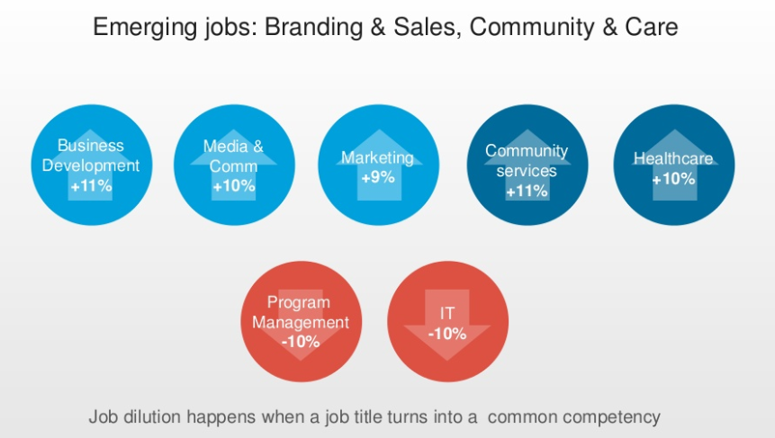
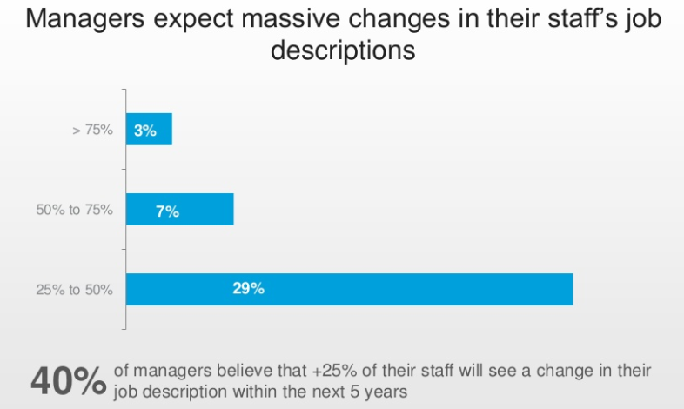
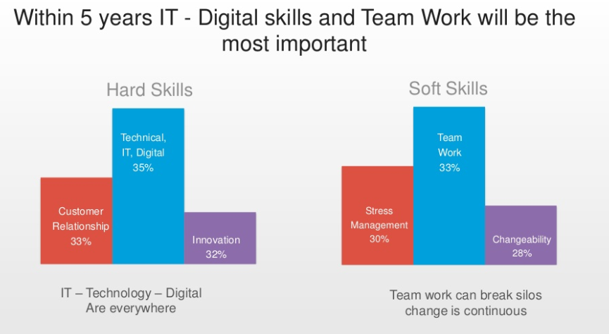
E&Y Talent revolution (Nov) 2013

Slide 7
The Migration: In-house / RPO
From phone in an order to find your own
From line manager to resourcing experts

Slide 8
RPO and In-House
Growth of RPO
Recession driven
2011, spending globally climbed to $1.4 billion, +$1.1 billion 2010
Scale up, scale down
Ability to manage volume
Builds operational process
Performance by numbers to manage commercials
Off-shore sourcing / admin models
Compliance within contractor workforces
Buying power across for sourcing channels
Technology expertise
Advanced data analytics
New in-house
Recession outcomes driving refocus
Increasing evidence that Shareholders recognize competitive advantage is intrinsically linked to Talent
Sourcing moves in-house EMEA
Sourcing outsourcing
Sourcing channel management
Social enablement
EVP & insights driving agenda
Technology enables global approach
Skills talent-pools
Internal & external pools together
Flexible workforce planning
Predictive data

Slide 9
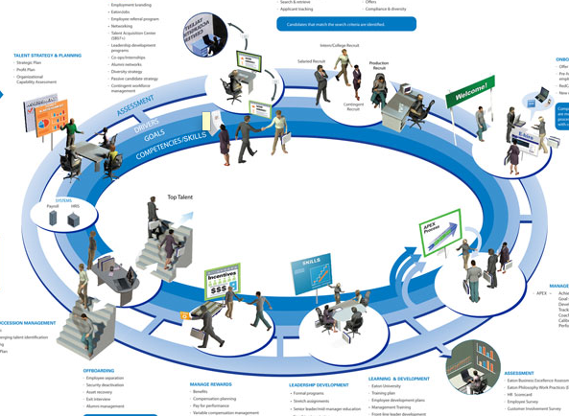
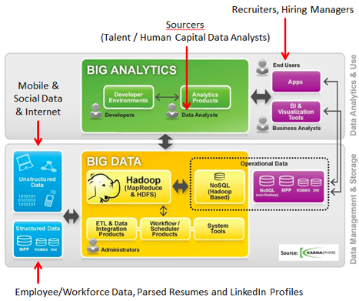
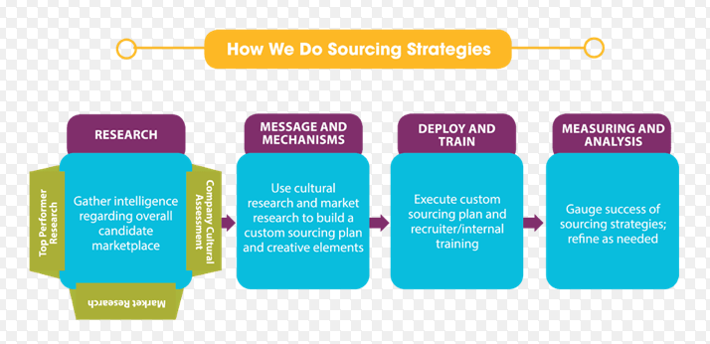
Similar focus
Data
Sourcing channels
Performance
Employer Brand
Insights
Engagement
Technology
CRM to ATS to HR
Mobile

Slide 10
Next Generation Social Direct Sourcing
From posting ads to new ways of searching
From only Linkedin to all channels

Slide 11
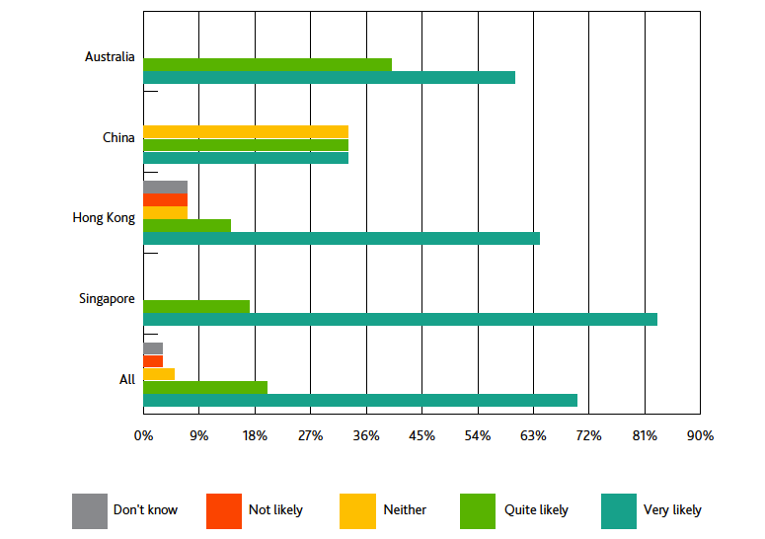
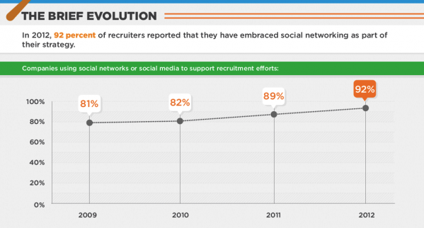
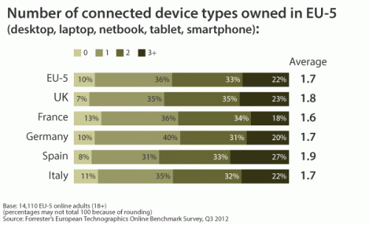
Evolution of Social Recruitment
APAC intentions
US adoption of social media for recruitment
Europe is connected

Slide 12
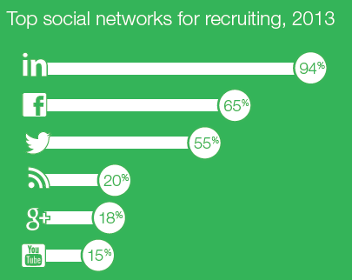
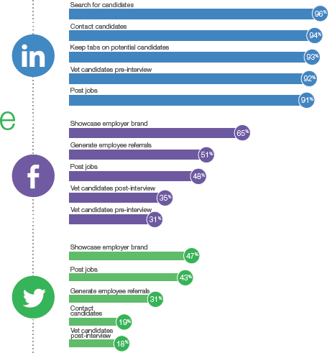
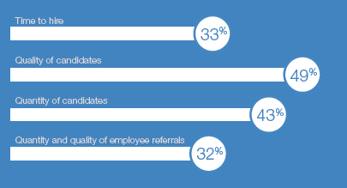
Latest Surveys on HR Usage USA
Source:
Jobvite 2013

Slide 13
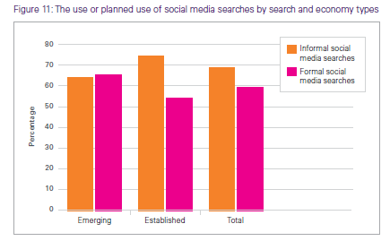
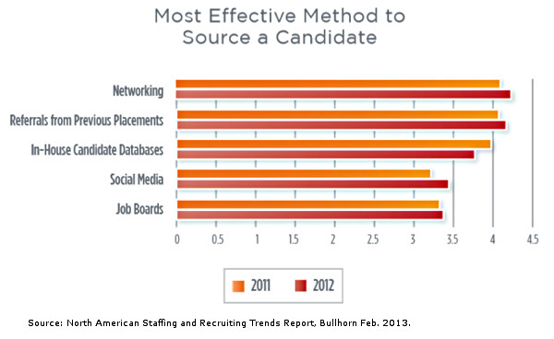
Surveys on HR Usage Global
Source:
SHL Global Assessment Trends 2013

Slide 14
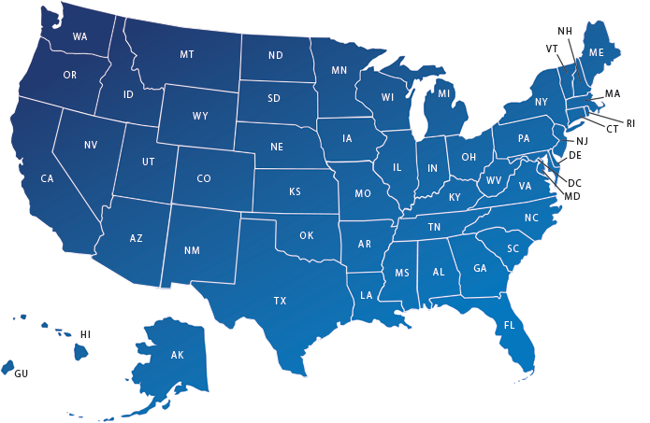
DIY Sizing the Audience http://www.linkedin.com/ads
10,356 LinkedIn Members associated with USA
470,950 LinkedIn Members who list their industry as Medical Devices
112,507 LinkedIn Members who have job category as Sales / BD
32% are +35 years old, 19% are 25-34, 3% are 18-24
Total number of users | 92.7 million
Penetration of population | 29%
Penetration of online population | 36%
67,454
13,357
2,036
12,485
2,955
<1,000
83,293
14,482
1,783
30,544
8,059
<1,000
#medical devices
Work in Sales / BD
Work 4 competitor
Source: socialbakers, LinkedIn Advertising
14

Slide 15
DIY Sizing the Audience http://www.facebook.com/ads
Total number of users | 170 million
Penetration of population | 54%
Penetration of online population | 66%
5,400 Facebook Members associated with USA
182,000 Facebook Members have liked #medical device – add #medical equipment increases 400,000
50% are +35 years old – 30% are +45 years old
3,400
1,780
60
2,600
1,040
20
26,000
9,800
70
11,800
5,200
40
#medical devices
University graduate
Work 4 competitor
Source: socialbakers, LinkedIn Advertising
15

Slide 16
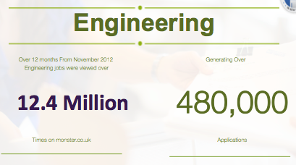
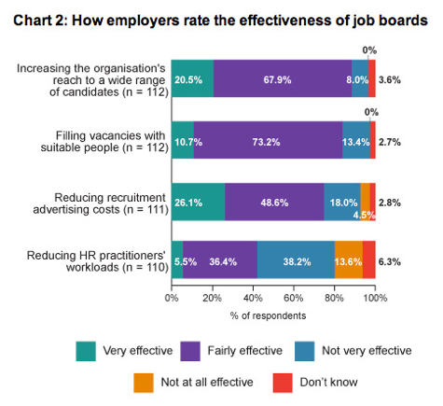
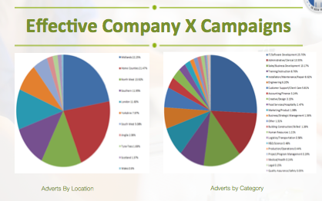
Demographics

Slide 17
Game Changer: Linkedin
Post a job to post a profile
CV database to network of connections
Candidate experience to market insights
Job clicks to recruiter performance

Slide 18
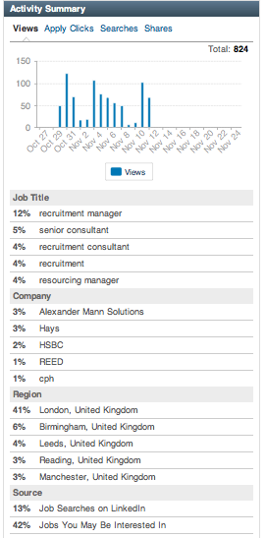
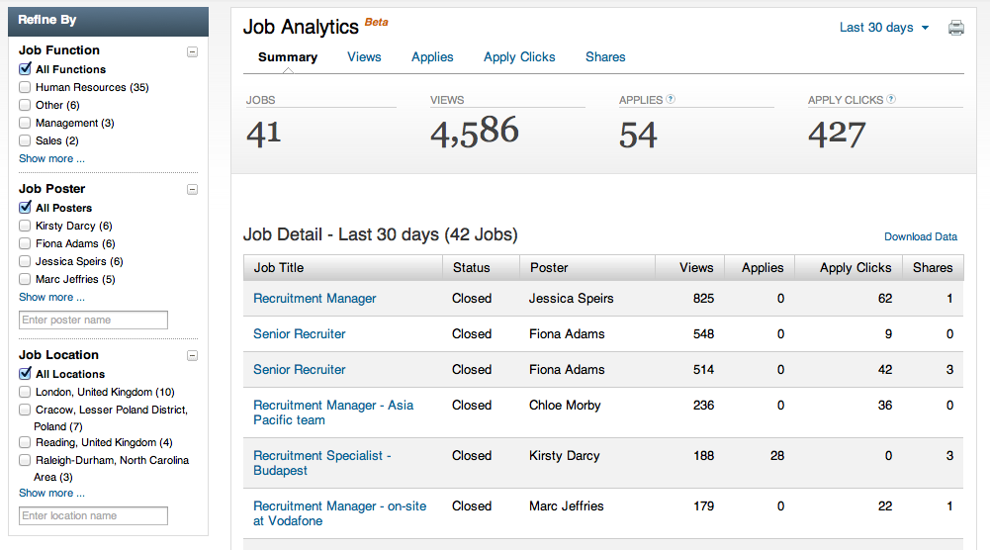
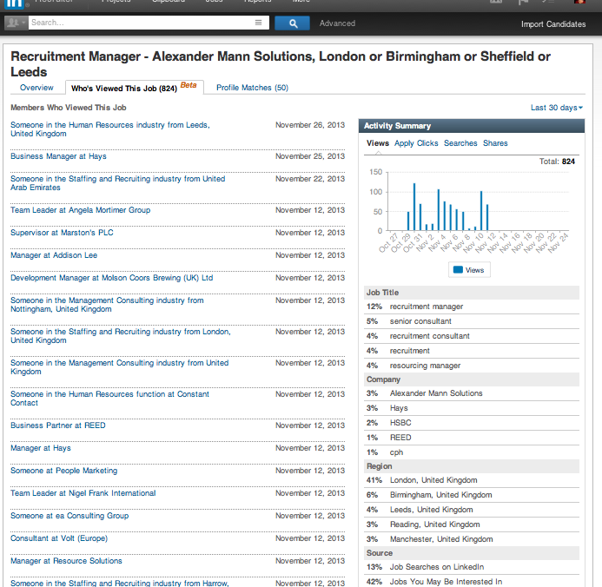
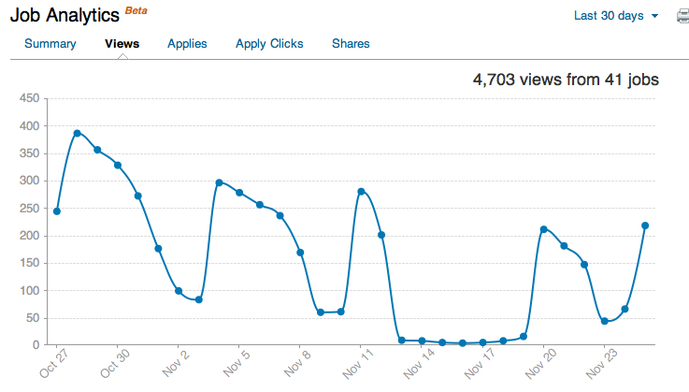
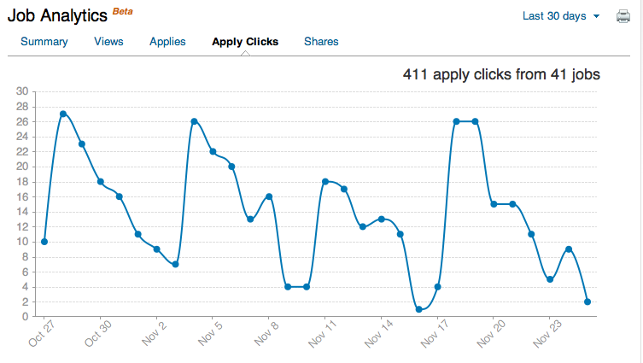
Job analytics

Slide 19
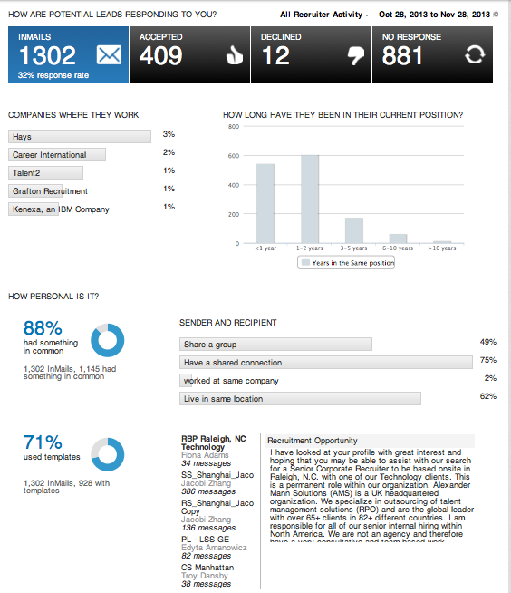
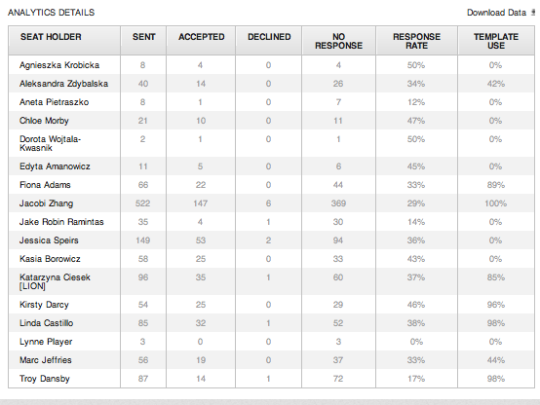
InMail usage

Slide 20
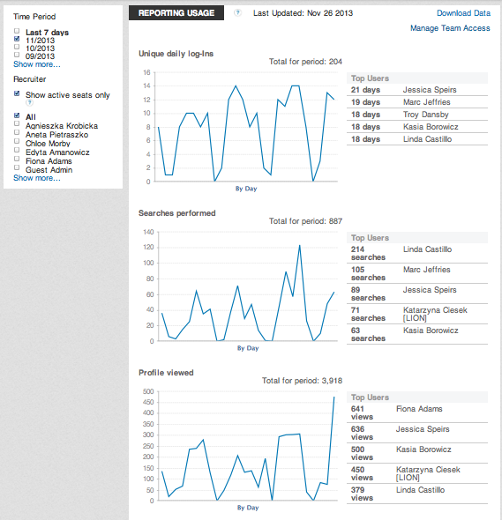
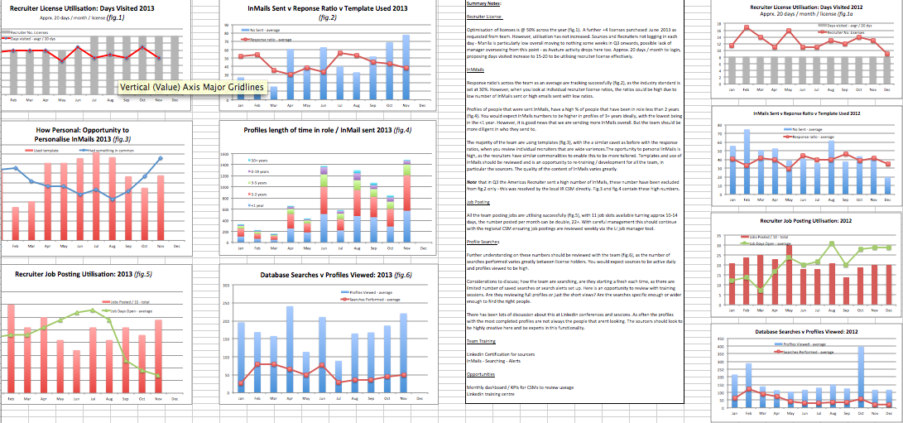
Recruiter activity

Slide 21
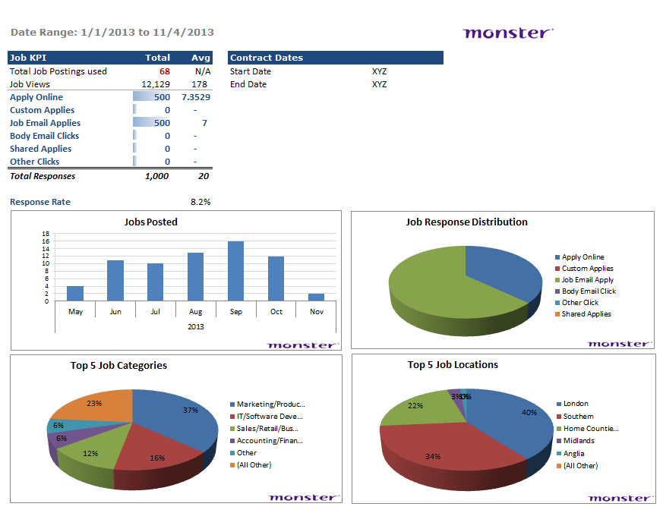
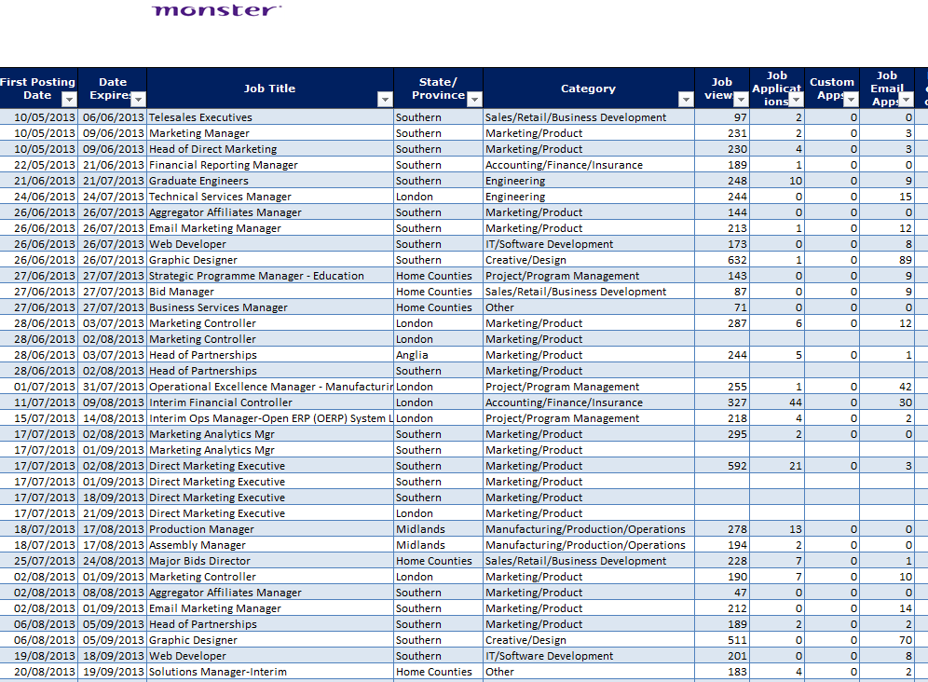
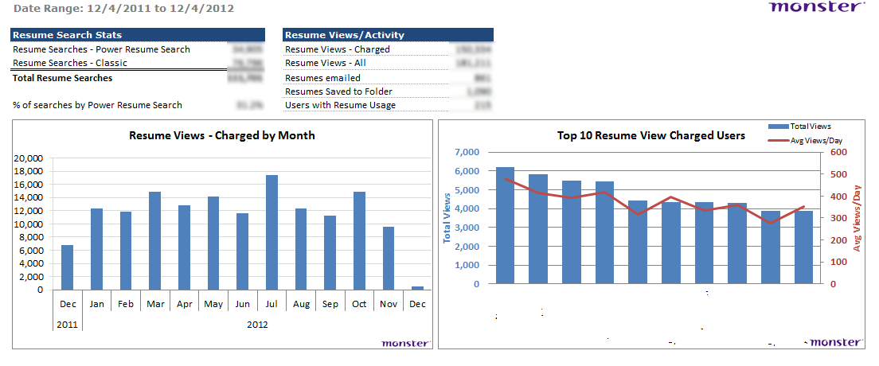
Job-board data

Slide 22
Mobile Opportunities
Wake-Travel-Work-Coffee-Work-Lunch-Work-Travel-Evening-Sleep
…becomes Mobile-Tablet-Desktop-Mobile-Desktop-Mobile-Desktop-Tablet-Mobile

Slide 23
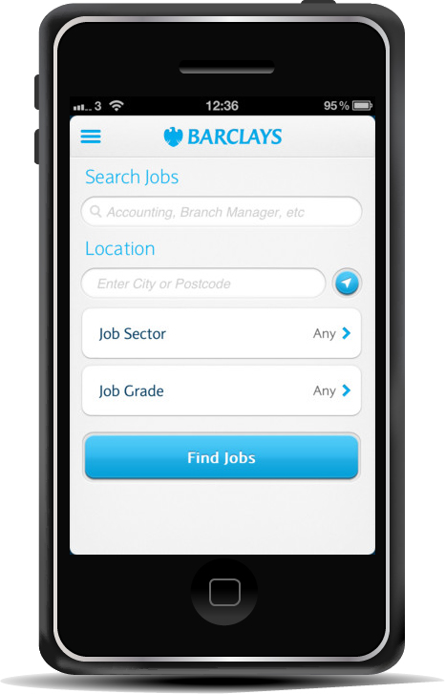
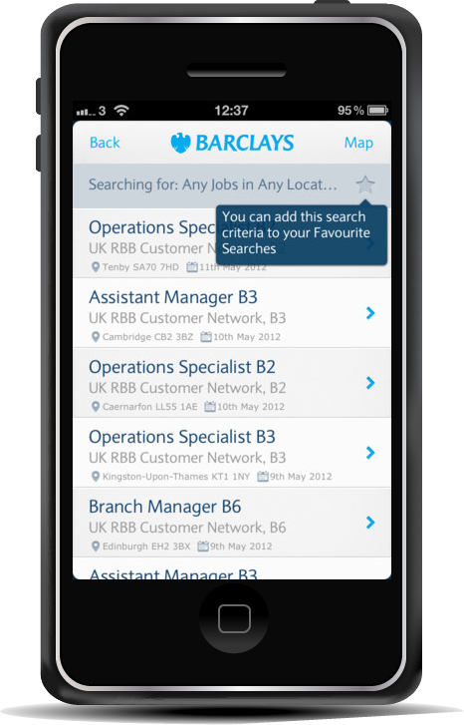
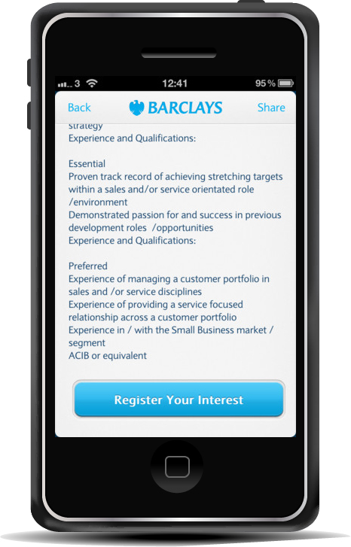
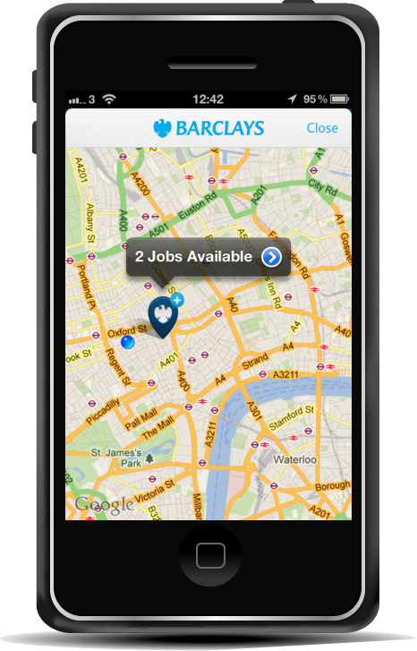
Mobile Application

Slide 24
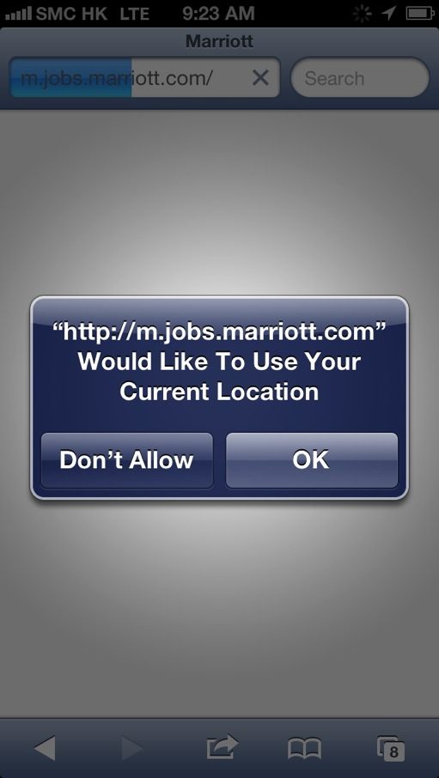
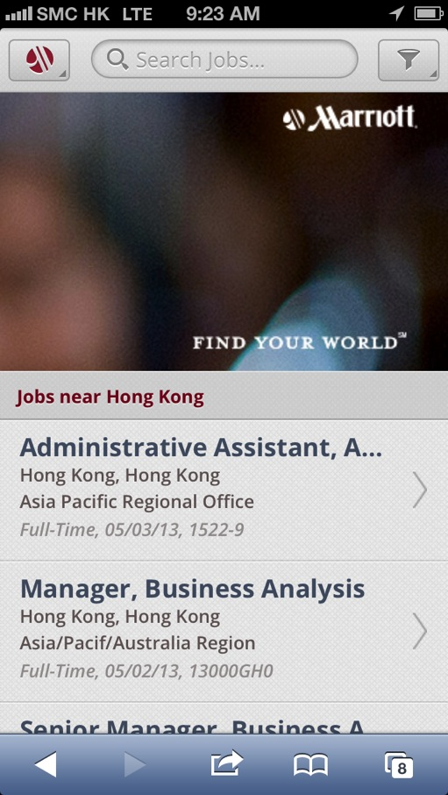
Mobile Candidate Experience

Slide 25
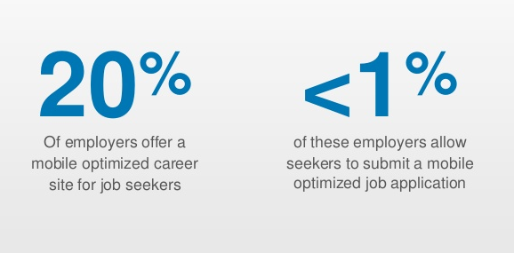
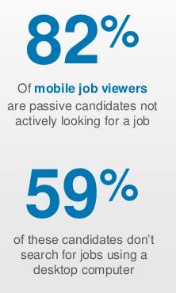
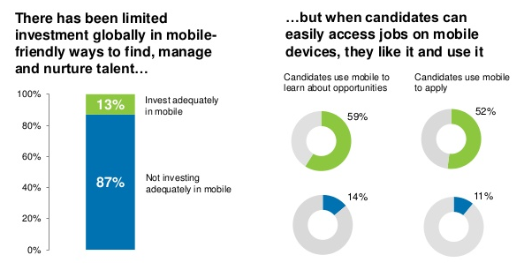
Opportunity?

Slide 26
Predictive Analytics
Analysing current and historical facts to make predictions about future, or otherwise unkown, events

Slide 27
We’re in a World of Big Data
“data sets whose size is beyond the ability of commonly used software tools to capture, manage, and process the data within a tolerable elapsed time”
Wikipedia

Slide 28
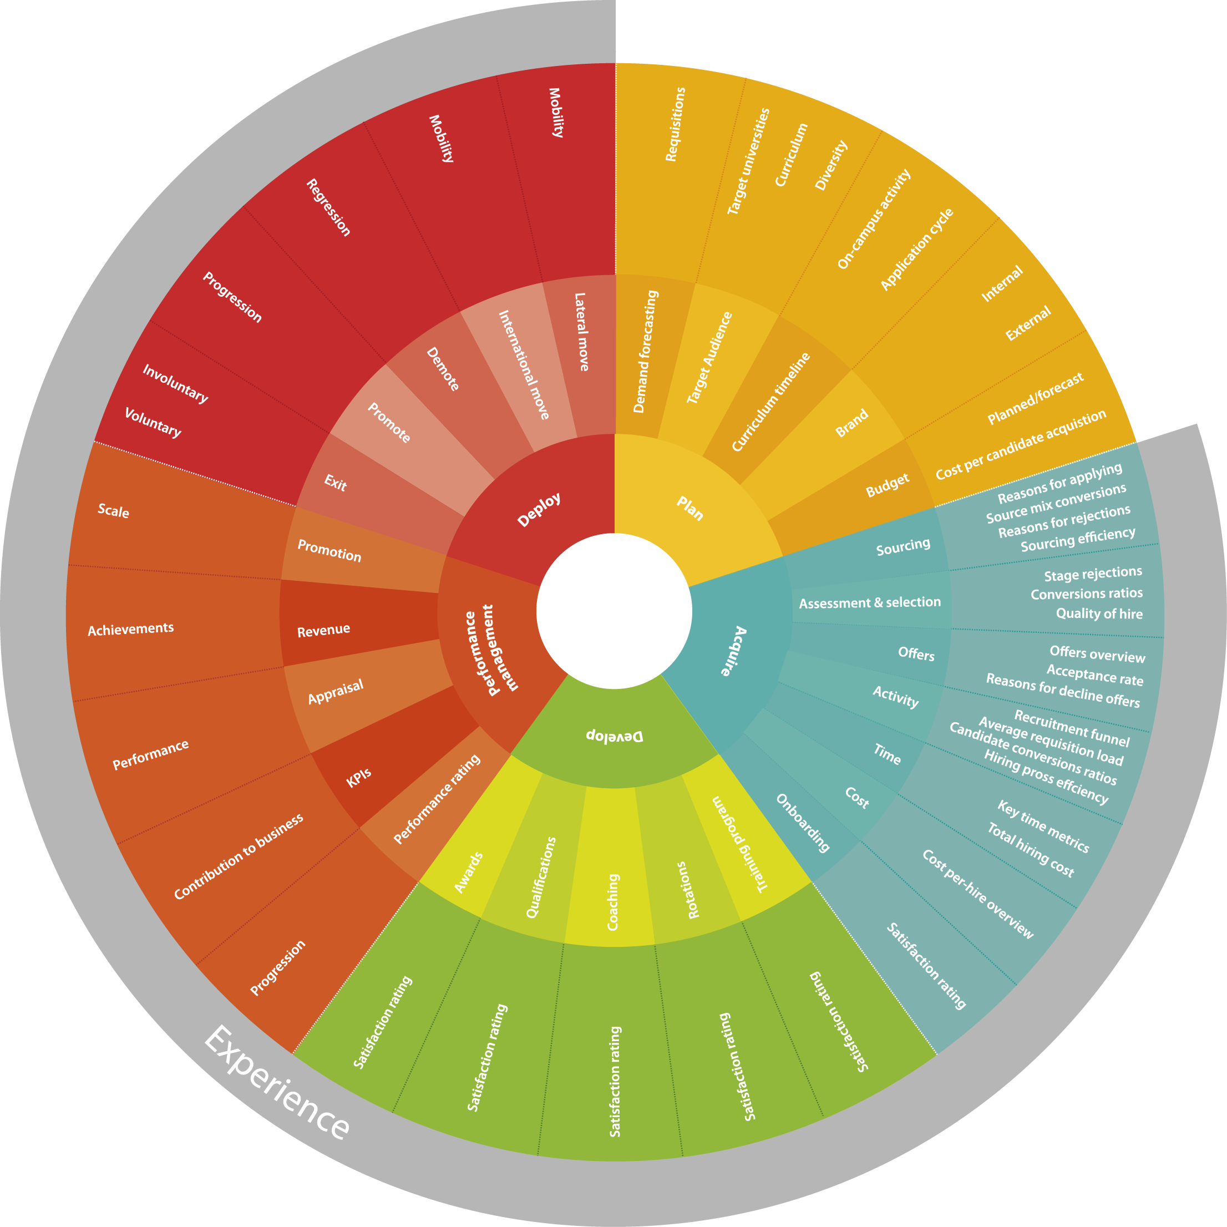
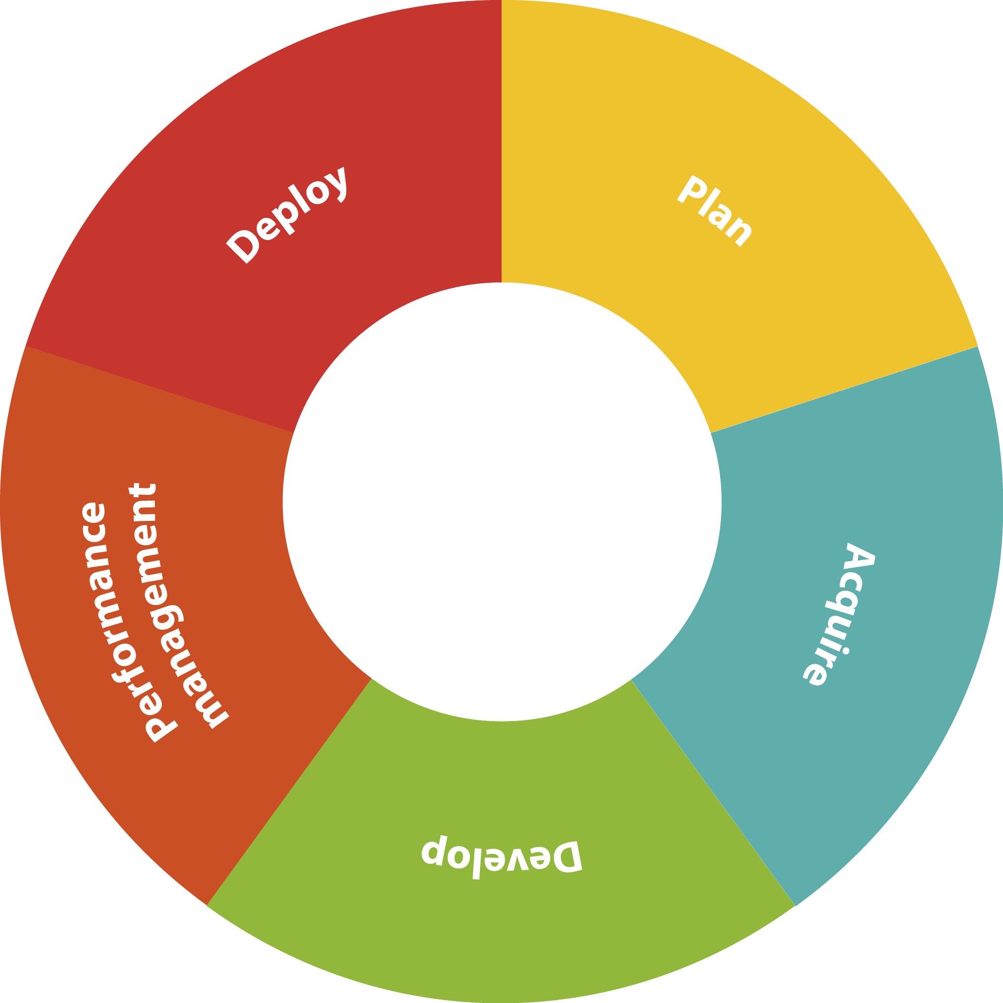
Think About Your Data Sources

Slide 29
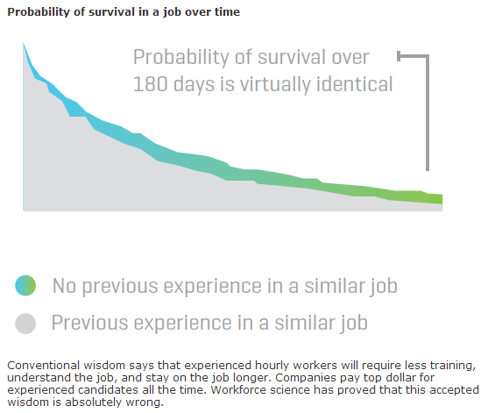
Sample Predictive Analytics

Slide 30
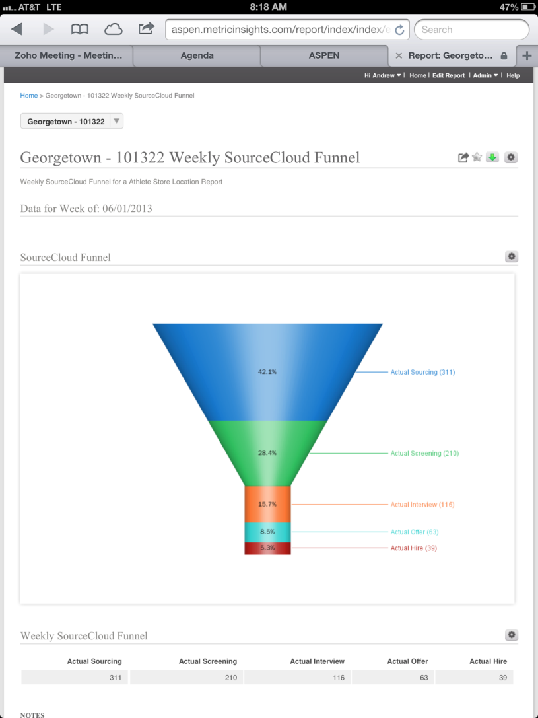
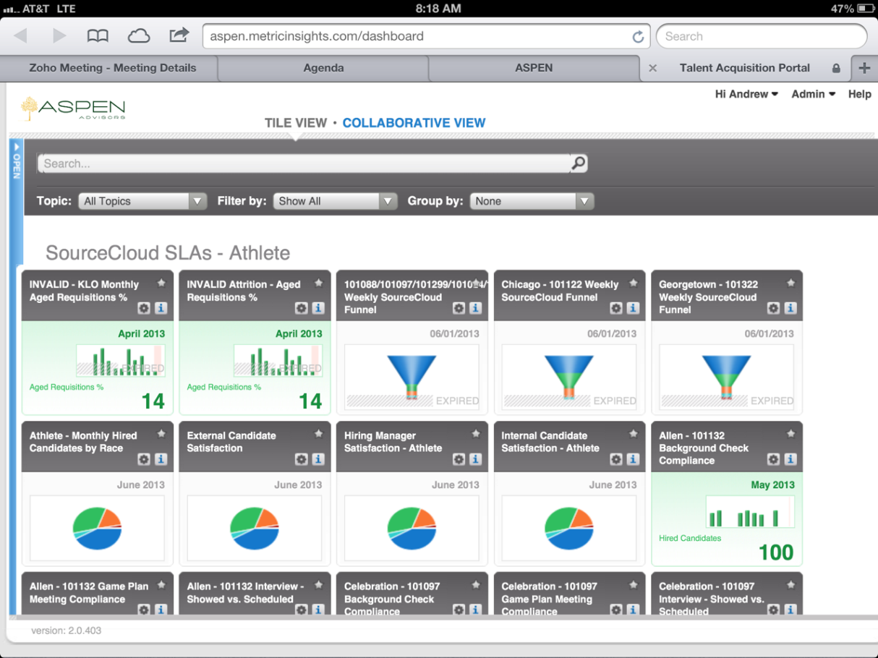
Nike Predicting Sourcing Success

Slide 31
Strategic Partner Evolution
Account management to sourcing partner
Product bundles to solution, insights and data

Slide 32
Over to you?

Slide 33
And something for the future……

Slide 34
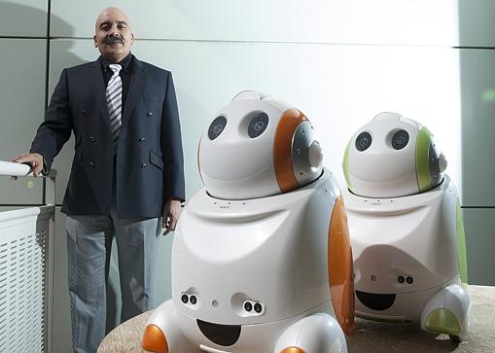
Robots!
The Data Points
A Recruiting Robot!

Slide 35
Thank you!
Isabelle Hung
Strategic Partners & Resourcing Projects

